Slide 1





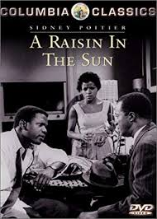
Ivan Wang

Slide 2

Pete Seeger - We Shall Overcome
In the play the setting takes place South Side, Chicago during the 1950’s. Which was a time of segregation. This song was a protest Song and was an key anthem of the Civil Right movement for the freedom and rights of people. In the play the Youngers especially Walter has a hard time with his job as a driver for rich white people.

Slide 3

Pet Shop Boys - Opportunities (Let's Make Lots of Money)
This song represents Walter Younger’s personality. He cares alot about money and his dream of a liquor business. This song represents Walter before being scammed.This song explains the opportunity people get to make money and the ability people have to help make money.

Slide 4
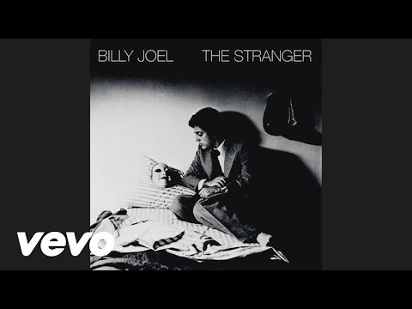
Billy Joel - Just the Way You Are
In the play Beneatha is in an relationship with Asagai. This relationship is alright as Asagai helps Beneatha go back to her roots and gives her advice. This song gives an similar type of relationship Asagai gives Beneatha.
relationship

Slide 5
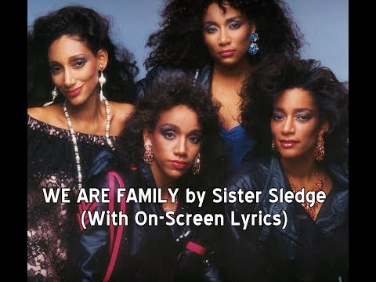
Sister Sledge - We Are Family
This song talks about family and how family is always together and they always support each other. The theme of the play is that family will always stick by you and support you. Like in the play Mama still supports Walter even though Walter loss the money. Mama also supports, and cares for the plant and the rest of the family.

Slide 6
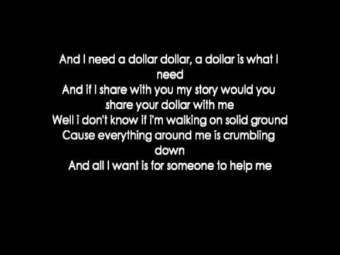
Aloe Blacc - I Need A Dollar
This song talks about money problems mainly the bad things. This is an man vs society conflict or it could be an man vs man conflict due to Walter getting scammed by Willy. Similar to A Raisin in the Sun where Walter needs money for the investment. This is one conflict that occurs in the play.

Slide 7

Bad Company - Moving On
This song talks about moving away or moving on. In the play, one major event is when the Younger family moved to a new home. The new home represents a new start to the family, and it’ll be an there home for the next generation.

Slide 8
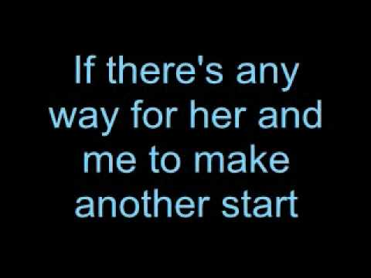
Chris Young - The Man I Want To Be
This song talks about becoming a man. In the end of the play Walter finally stood up and told Mr.lindner that he and his family are going to moving in. At this point of the play Walter became an man.

